Slide 1

Boolean methods and the use of the Utilities class
The use of Boolean methods
Produced
by:
Dr. Siobhán Drohan
Ms. Mairead Meagher
Department of Computing and Mathematics
http://www.wit.ie/

Slide 2
Topics list
Regular expressions
Methods with int return type
Boolean methods
Utilities class
equals() method

Slide 3
Regular Expressions
Regular Expression
‘A sequence of symbols and characters expressing a string or pattern to be searched for within a longer piece of text.’

Slide 4
Resources
https://regexone.com/ (good interactive site)
This site has what you need but looks a bit busy:
  https://www.regular-expressions.info/numericranges.html
This site has a nice chart of what all the symbols need.
  https://www.w3schools.com/jsref/jsref_obj_regexp.asp
CHEATSHEET
  https://cheatography.com/davechild/cheat-sheets/regular-expressions/

Slide 5
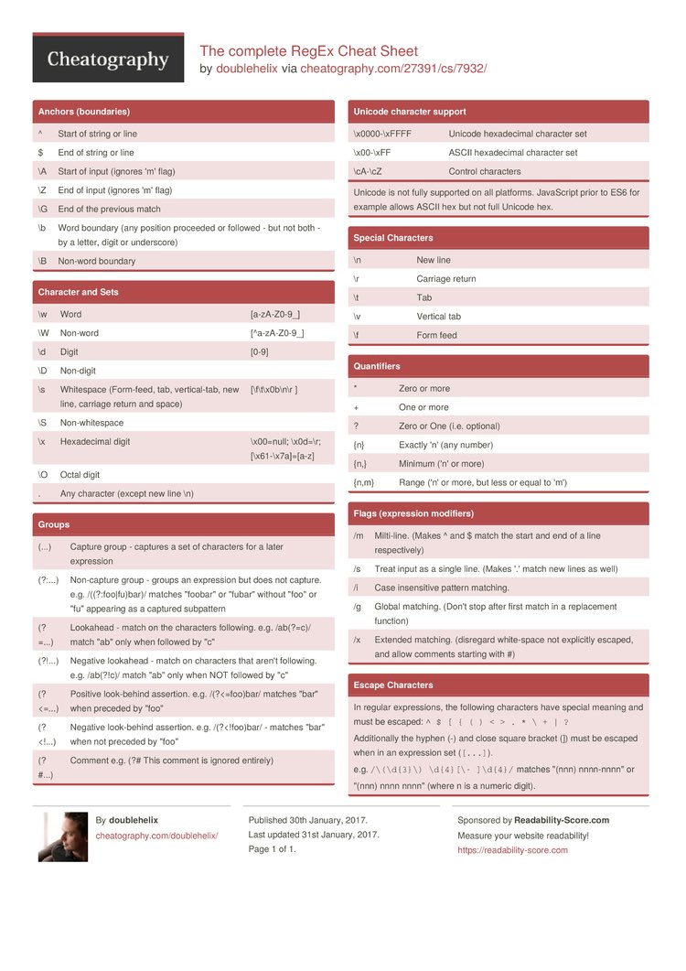
CheatSheet

Slide 6
How to use Regular Expressions in Utilities
static boolean onlyContainsNumbers(String text) {
return (text.matches("[0-9]+"));
}
}
Regular expression pattern – this means
‘any number of digits’

Slide 7
Topics list
Regular expressions
Methods with int return type
Boolean methods
Utilities class
equals() method

Slide 8
Example 1. Methods with int return type
public int addTwoNumbers1(int num1, int num2) {
int total;
total = num1 + num2;
return total;
}
Called as
int myVar = addTwoNumbers1(4,5);
System.out.println("The result is " + myVar);
And this is printed to the console
The result is 9

Slide 9
Example 2. Methods with int return type
public int addTwoNumbers1(int num1, int num2) {
return (num1 + num2);
}
Returns the value directly without use of temporary variable
Called as
int myVar = addTwoNumbers1(4,5);
System.out.println("The result is " + myVar);
And this is printed to the console
The result is 9

Slide 10
Example 3. Methods with int return type – calling the function directly
public int addTwoNumbers1(int num1, int num2) {
return (num1 + num2);
}
Call the method directly in the print statement
System.out.println("The result is " + addTwoNumbers1(4,5));
And this is printed to the console
The result is 9

Slide 11
Exercise 1 . Methods with int return type
Exercise 1. Write a method that takes in three integer parameters and returns the sum of those values.
public int addThreeNumbers(int num1, int num2 ,int num3) {
return (num1 + num2 + num3);
}

Slide 12
Topics list
Regular expressions
Methods with int return type
Boolean methods
Utilities class
equals() method

Slide 13
Example 4. Methods with boolean return type.
Write a method that returns true if t (integer ) parameter value is greater than 10 and false otherwise.
public boolean overTen1(int i) {
if (i>10) return true;
else return false;
}
Called as
int x = 17;
if (overTen1(x) == true )
System.out.println("This value : " + x + "is greater than 10" );
else
System.out.println("This value : " + x + "is not greater than 10" );

Slide 14
Example 5. Methods with boolean return type. (Direct use of condition)
Write a method that returns true if an (integer ) parameter value is greater than 10 and false otherwise.
public static boolean overTen2(int i) {
return (i>10); // returns the value of the condition directly
}
Called as
int x = 17;
if (overTen1(x) == true )
System.out.println("This value : " + x + "is greater than 10" );
else
System.out.println("This value : " + x + "is not greater than 10" );

Slide 15
Example 6. Methods with boolean return type. (Direct use of condition in call of method)
Write a method that returns true if an (integer ) parameter value is greater than 10 and false otherwise.
public static boolean overTen2(int i) {
return (i>10); // returns the value of the condition directly
}
Called as
if (overTen1(x)) //calling method directly in condition
System.out.println("This value : " + x + "is greater than 10" );
else
System.out.println("This value : " + x + "is not greater than 10" );
}

Slide 16
Example 7. Methods with boolean return type. (Use of NOT in call)
Write a method that returns true if an (integer ) parameter value is greater than 10 and false otherwise.
public static boolean overTen2(int i) {
return (i>10); // returns the value of the condition directly
}
Called as
if (!overTen1(x)) //calling method directly in condition
System.out.println("This value : " + x + "is NOT greater than 10" );
else
System.out.println("This value : " + x + "is greater than 10" );
}

Slide 17
If you are testing this code..
public static void main(String[] args) {
// call the methods
}
Add the static modifier to all the methods
public static int addTwoNumbers2(int num1, int num2) {
return (num1 + num2);
}
Source: Reas & Fry (2014)

Slide 18
Topics list
Regular expressions
Methods with int return type
Boolean methods
Utilities class
equals() method

Slide 19
Utilities Class
Utilities Class will contain a collection of ‘useful’, reusable methods.
These methods will not depend on any fields of the class, and solely on the parameters of the methods.
Because there are no fields, there is no need to have objects of this class. We use the methods directly from the class
To do this, we
  Add the static modifier to the methods
  Call the methods using the Class name, not the object name.

Slide 20
Utilities Class
To do this, we
  Add the static modifier to the methods
  Call the methods using the Class name, not the object name.
public static boolean overTen2(int i) {
return (i>10);
}
If (Utilities.overTen2(6) ) {
System.out.println (“Over ten”);
else
System.out.println (“Not over ten”);

Slide 21
Topics list
Regular expressions
Methods with int return type
Boolean methods
Utilities class
equals() method

Slide 22
equals() method
What do we mean by two objects being equal?
If we wish to check that two objects contain the same values (as opposed to being stored at the same address), we can use the equals() method.
Similar to toString(), there is a high-level version of equals() written, but we can make this more specific by writing this more locally in the class (thus overloading the method).
So you an decide exactly what it means for two objects to be equal.

Slide 23
equals() method
public class SimpleClass {
int x;
int y;
SimpleClass(int x, int y) { //constructor
this.x = x;
this.y = y;
}
int getX(){ return x;}
int getY(){ return y;}
public boolean equals(SimpleClass otherSimpleClassObject) {
return (this.x == otherSimpleClassObject.getX() &&
this.y == otherSimpleClassObject.getY() );
}
}

Slide 24
equals() method
We define equals with one parameter
- an object of the same class
For two SimpleClass objects to be equal, each of the their integer fields of the first object must be equal to the other object’s integer fields.
public boolean equals(SimpleClass otherSimpleClassObject) {
return (this.x == otherSimpleClassObject.getX() &&
this.y == otherSimpleClassObject.getY() );
}
}

Slide 25
Using the equals() method
public boolean equals(SimpleClass otherSimpleClassObject) {
return (this.x == otherSimpleClassObject.getX() &&
this.y == otherSimpleClassObject.getY() );
}
}
{ //code snippet
SimpleClass object1, object 2;
object1 = new SimpleClass(4,5); //different objects but the same values
object2 = new SimpleClass(4,5);
If (object1.equals(object2) )
System.out.println(“objects have equal values”);
}

Slide 26

Questions?

